Slide 1
To-Do Tracker
Project developed by –
Nikhil Khetan
Logeswari Dillibabu
Divye Kataria
Batch no: SE91S9

Slide 2
About Team Members
Name : Nikhil Khetan Qualification : Completed B.COM (Batch 2022) Email id- nikhilkhetan22@gmail.com Name : Divye Kataria Qualification : Completed B.Tech in Civil Engineering (Batch 2023) Email id- divyekataria@gmail.com Name : Logeswari Dillibabu Qualification : Completed B.Tech in IT (Batch 2020) Email id- logeswaridillibabu96@gmail.com

Slide 3
Agenda
To develop a full stack To-Do Tracker application using Spring Boot and Angular, which allows users to seamlessly manage their tasks by providing functionalities such as user authentication, task creation, deletion, and updation.

Slide 4

Introduction
To-Do Tracker is a powerful tool designed to simplify your life by helping you organize, prioritize and track your tasks with ease.
Categorize tasks based on priority, providing you with a comprehensive overview of your workload.
Keeping track of your tasks and staying on top of responsibilities can be challenging. To-Do tracker takes care of it all.

Slide 5
Features
Easily sign in or register to access your personalized task management.
Add, update, and delete tasks effortlessly.
Completed tasks can be sent to archive.
Tasks can only be deleted if they are completed.
Modern and visually appealing interface for a delightful user experience.
Made Responsive across all devices.

Slide 6
Tools and Technologies used
Front-End technologies
HTML
CSS
TypeScript (Programming Language)
Angular
Angular Material for Designing
Visual Studio Code
Back-End technologies
Spring boot
Java (Programming Language)
JWT
MySQL
MongoDB
Postman
IntelliJ
DB technologies

Slide 7
Front-End Architecture
Components
Services
Models
App
Add-Todo
Dashboard
Edit-Todo
Filter
Footer
Header
Home
Login
Page-not-found
Sign-up
Archive
Auth-guard
Can-deactivate
Http-interceptor
Login
Register
Todo-data
Todo
User

Slide 8
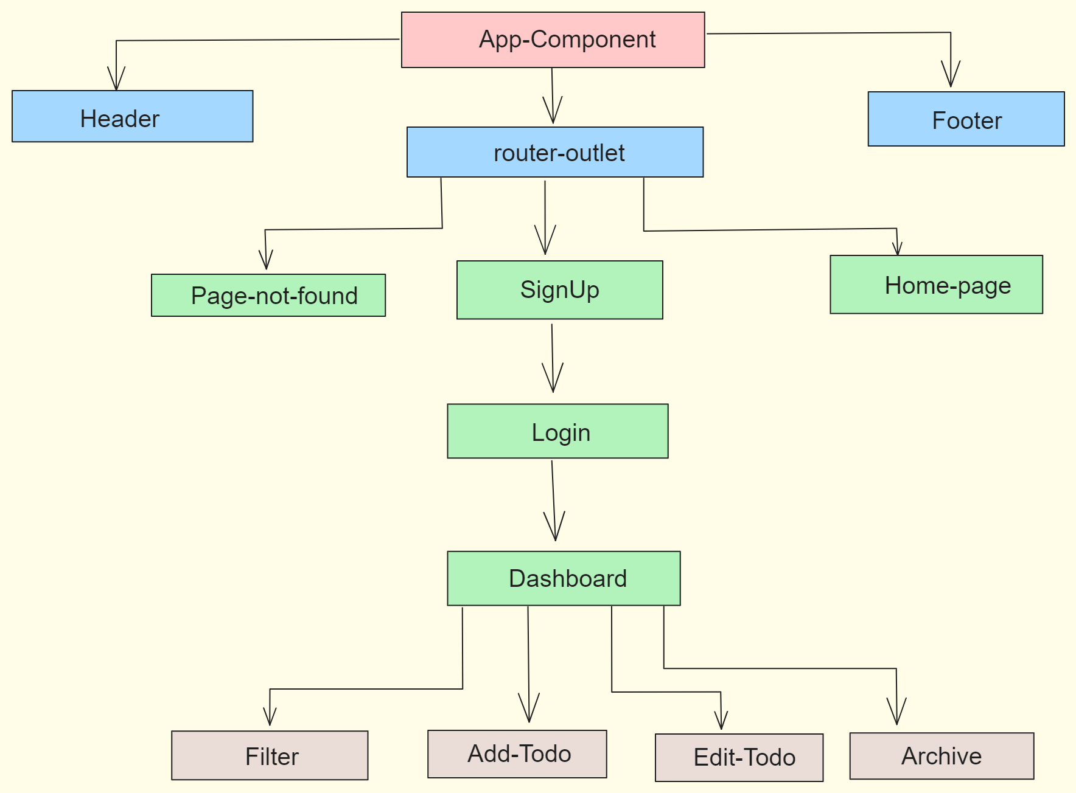
Front-End Flow Diagram

Slide 9
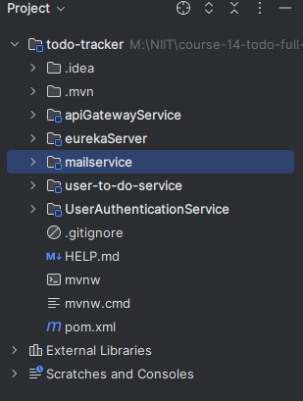
Back-End Architecture
Microservice created:
Eureka Server
API-Gateway Service
User To-Do Service
User Authentication Service
Mail Service

Slide 10
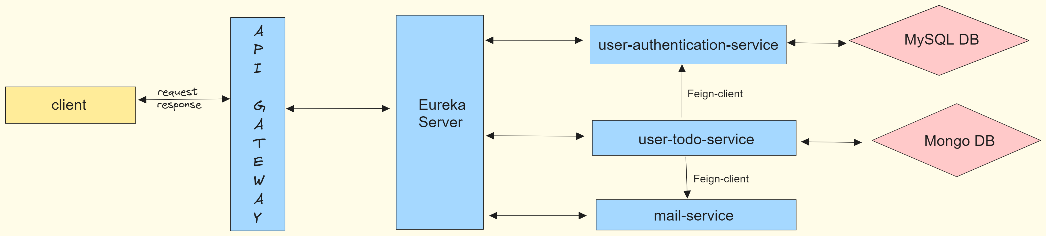
Back-End Flow Diagram

Slide 11
Project Demo

Slide 12
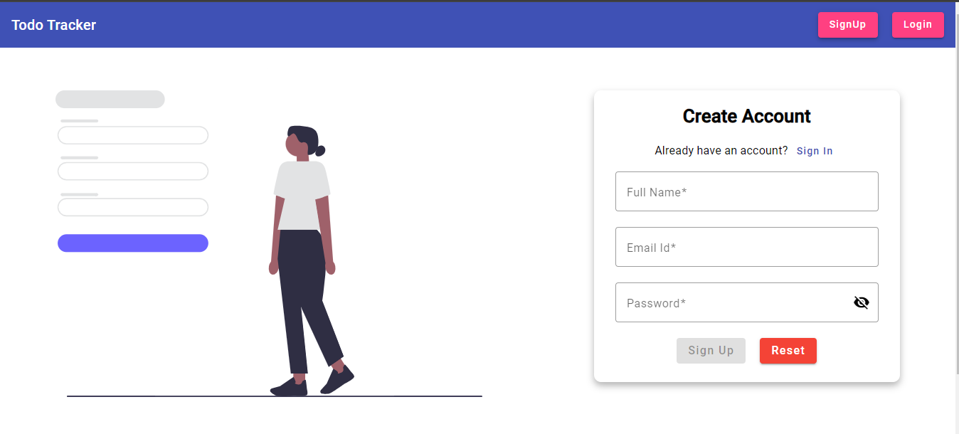
Registration Page

Slide 13
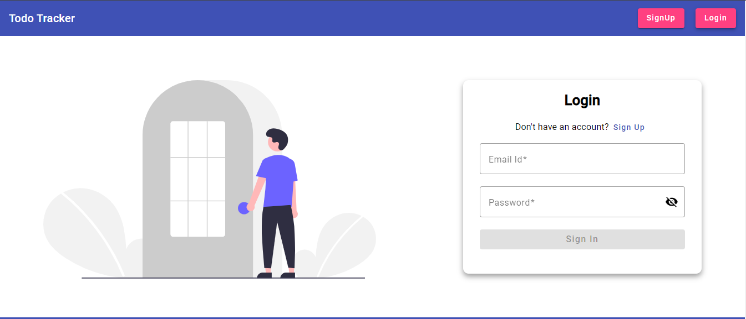
Login Page

Slide 14
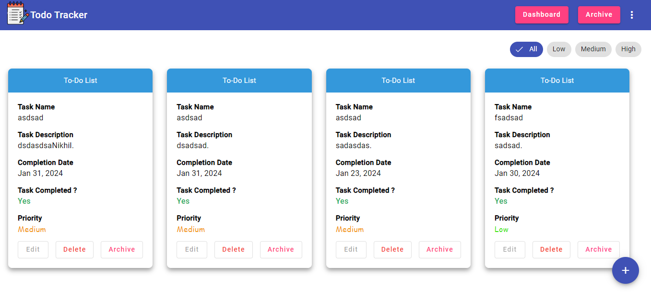
Dashboard Page

Slide 15
Bibliography
https://angular.io/ for angular framework.
https://material.angular.io/ for front-end designing.
https://excalidraw.com/ for making diagrams
https://jwt.io/ for authentication
https://www.geeksforgeeks.org/spring-boot-sending-email-via-smtp/ for mail service.
https://undraw.co/illustrations for images.
https://stackoverflow.com/ for resolving errors.

Slide 16
Future Enhancement
Allow users to reset their password in case of a forgotten password by providing a "Forgot Password" option on the login screen.
Allow users to delete their accounts, ensuring data privacy and giving them full control over their account information.
Implement reminders for tasks with the option to receive notifications (email or SMS) at specified times or intervals.
Provide a dark mode option for users who prefer a different visual style and want to reduce eye strain during night time usage.

Slide 17
Conclusion
By combining the robust backend capabilities of Spring Boot with the dynamic frontend of Angular, we aim to deliver a highly functional and secure to-do tracker application. This project not only demonstrates the integration of these technologies but also showcases best practices in terms of security, user experience, and scalability.

Slide 18
thank you
Course Mentor -
Sandhyasri Angara Mam

Slide 19

Any Questions ?

